Slide 1
O Guia do Mochileiro das Galáxias [The Hitchhiker’s Guide To The Galaxy] (2005)
aprendizado
supervisionado
MAC 425 / 5739
Inteligência Artificial

Slide 2
contexto
✔︎ Parte I - Busca em espaço de estados
✔︎ Parte 2 – Raciocínio Lógico
✔︎ Parte 3 - Raciocínio Probabilístico e Tomada de decisão sob incerteza
Parte 4 - Aprendizado de máquina
✔Aprendizado por reforço
Aprendizado supervisionado
Aprendizado profundo

Slide 3
If asked why we believe the sun will rise tomorrow, we shall naturally answer, “Because it has always risen every day.” We have a firm belief that it will rise in the future, because it has risen in the past.
-Bertrand Russel

Slide 4
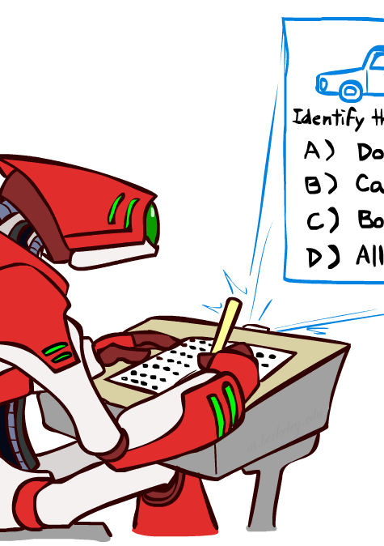
learning
Memorizing patterns/rules
Abstracting concepts
Adapting behavior
necessary for unknown/changing environments (transition/reward model is partly or fully unknown)
Problem definition not formalizable
reduce cost of system design (human labor) some systems are too complex to be fully specified
Notes:
We have seen a particularly type of learning known as reinforcement learning, which is a type of learning by incentives, and geared towards designing behaviors in dynamic environments
In this lecture we will be more concerned with static environments and with simple behaviors (e.g., greedy).

Slide 5
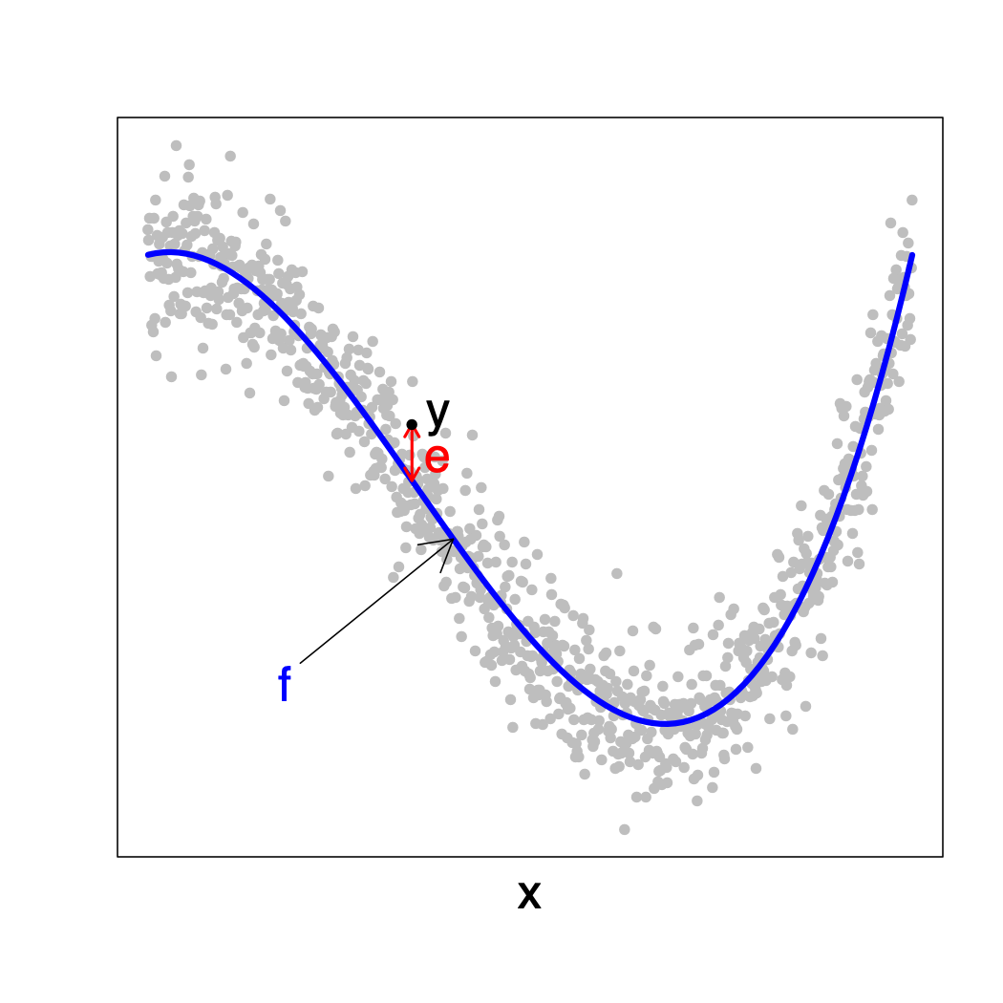
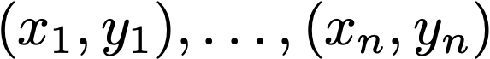
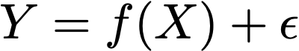
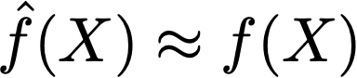
supervised Learning Problem
Known:
Assumed:
Objective:

Slide 6
supervised learning
Assumptions
Stimulus-response pairs are independently and identically distributed from some (unknown) distribution
Objective
Learn a function that maps unseen stimulus into response
Notes:
In supervised learning, the goal is to learn by example (or demonstration) in a static environment

Slide 7
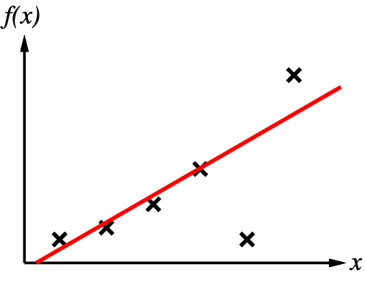
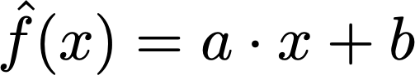
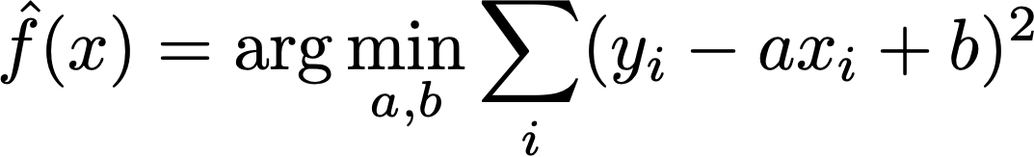
supervised learning method
Comprises a class of candidate functions
A learning algorithm that maps a data set into a function in candidate set
Example
Candidates:
Learning algorithm:

Slide 8
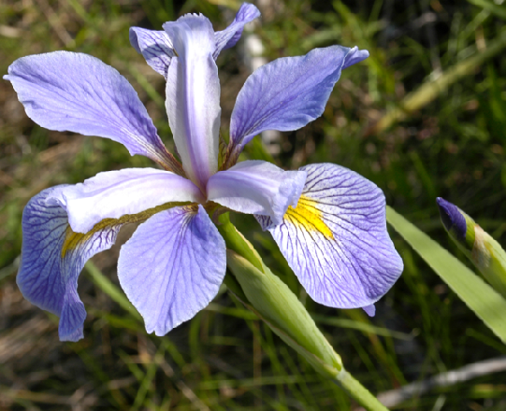
factored representation
Multidimensional state representation:
Each dimension is called attribute, feature, or characteristic
Some problems have factored output as well (out of the scope of this course)
Sepal length | Sepal width | Petal length | Petal width
5.0 | 2.0 | 3.5 | 1.0
6.0 | 2.2 | 4.0 | 1.0
6.2 | 2.2 | 4.5 | 1.5
6.0 | 2.2 | 5.0 | 1.5
4.5 | 2.3 | 1.3 | 0.3
… | … | … | …

Slide 9
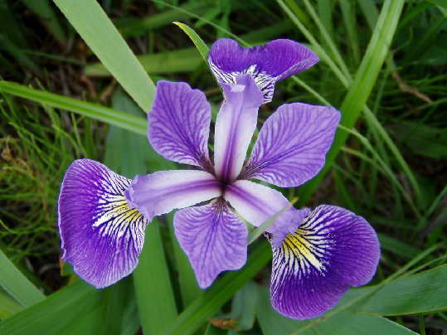
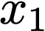
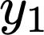
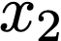
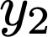
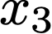
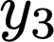
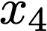
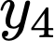
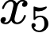
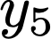

Iris flowers data set
Morphological data about different species of iris flowers
150 records (instances, rows, inputs, examples)
Associated task: classify specifies based on measurements
numerical, continuous, real valued
categorical, discrete
Sepal length | Sepal width | Petal length | Petal width | Species
5.0 | 2.0 | 3.5 | 1.0 | I. versicolor
6.0 | 2.2 | 4.0 | 1.0 | I. versicolor
6.2 | 2.2 | 4.5 | 1.5 | I. versicolor
6.0 | 2.2 | 5.0 | 1.5 | I. virginica
4.5 | 2.3 | 1.3 | 0.3 | I. setosa
… | … | … | … | …

Slide 10
supervised learning
Known:
Y | Problem
continuous | regression
categorical | classification
Assumed:
Objective:

Slide 11
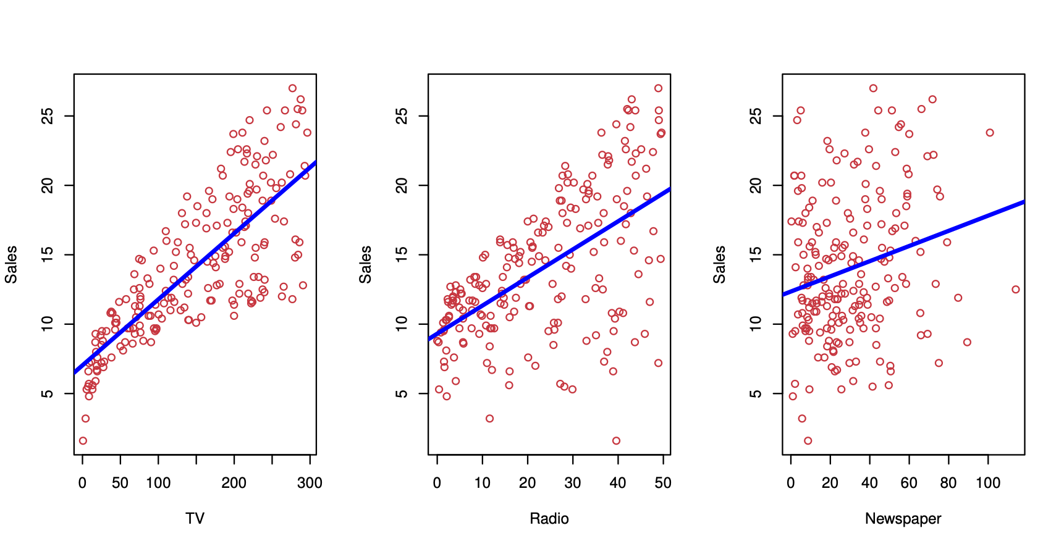
regression
Predict sales revenue increase by type of advertisement

Slide 12
regression: approximate q-learning
Q-Value function from state-action-future reward triples
E.g. Using linear combinations

Slide 13
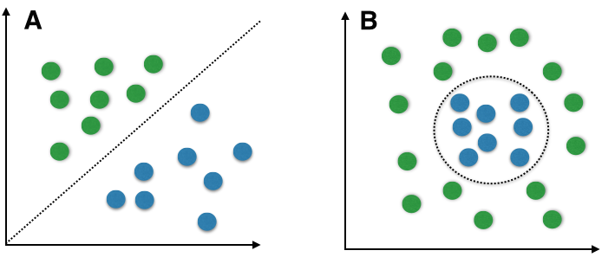
classification
Separable
Unseparable
Given data set of i.i.d. observations of object-labels pairs, estimate f(object) ↦ label

Slide 14

internet advertisements
Information related to images displayed in internet websites: geometry of the image (if available), phrases occurring in the URL, image's URL and alt text, anchor text, words occurring near the anchor text.
Associated task: predict wether image is an ad

Slide 15
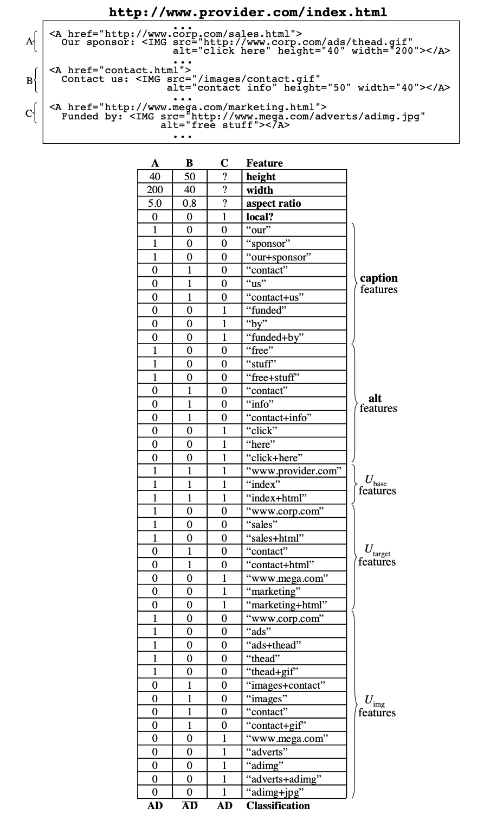
internet advertisements
3279 instances, 1558+1 attributes
Attributes:
categorical, integer, numeric

Slide 16
SPAM base
Collection of text from email messages categorized as spam and not-spam
4601 instances
58 attributes:
48 numeric descriptors of word frequencies
6 numeric descriptors of character frequency
3 numeric descriptors of sequences of capital letters (average/max length, total number of capital letters)
1 categorical (spam/not-spam)

Slide 17
classification
Extensive list of applications
OCR: input is images, output is written text
Medical diagnosis: input is a list of findings, output is disease
Essay grading: input is text document, output is grade
Fraud detection: input is transaction, output is yes/no
Speech recognition: input is recorded voice signal, output is spoken word/sentence
…
Widespread use
One of AI’s most popular technology (it actually works!)

Slide 18
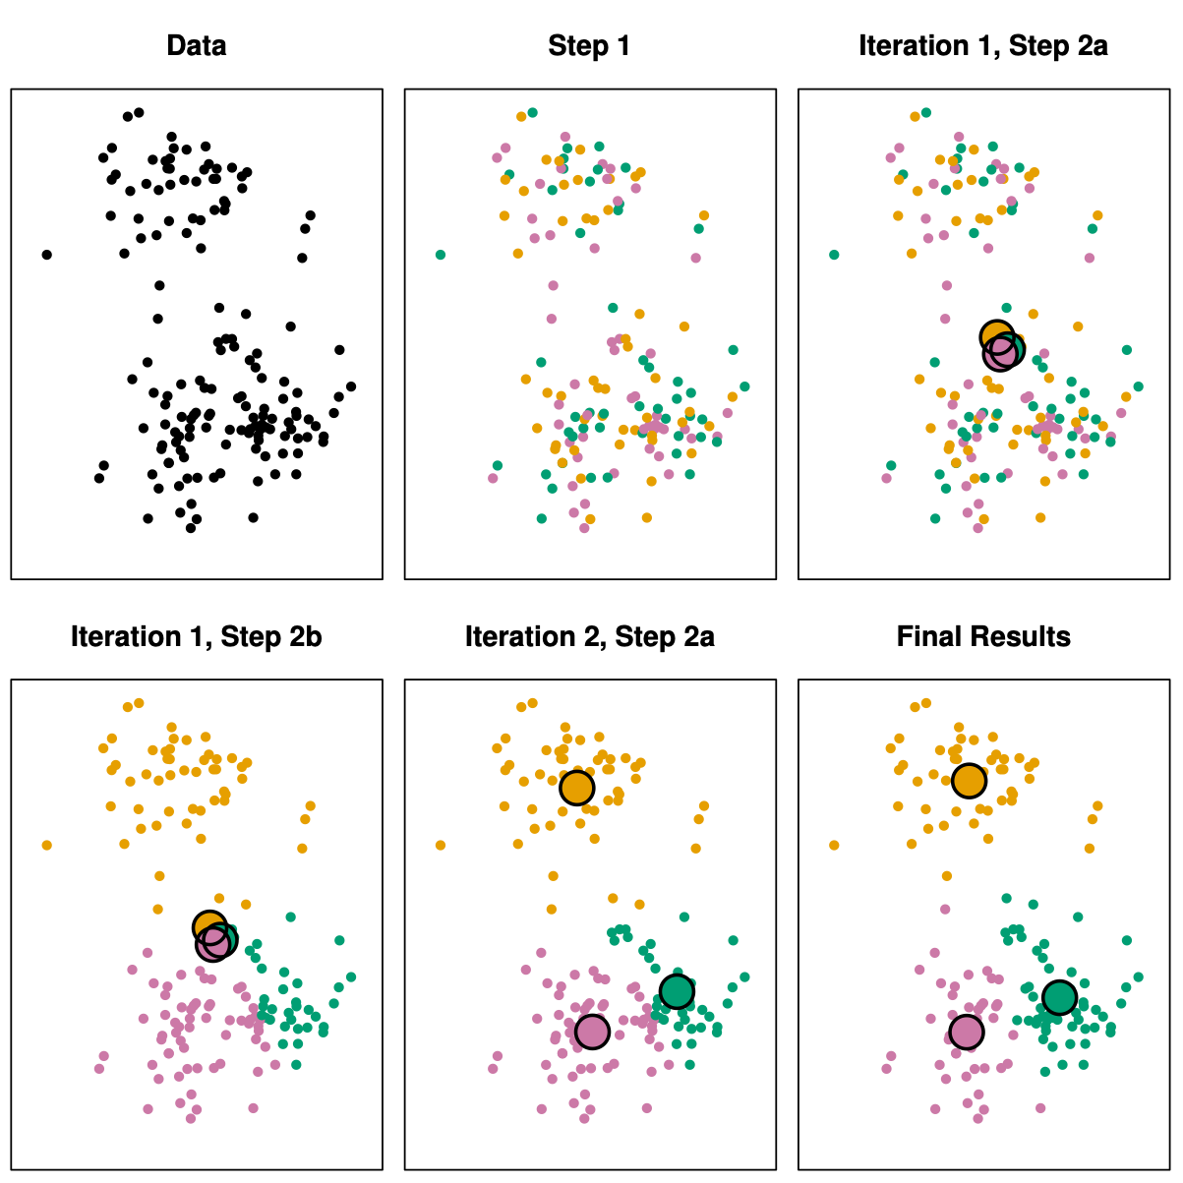
Text
clustering

Slide 19
Text
clustering

Slide 20
model-based learning (parametric)
Build statistical model of data (independences, distribution family, etc)
Input and output are random variables
Classify by maximizing probability of class label given instance
Regress by computing expected value of output given input
Challenges:
How to learn/select structural parameters (linear, quadratic, sin)?
How to learn/estimate numerical parameters (weights of linear model)?

Slide 21
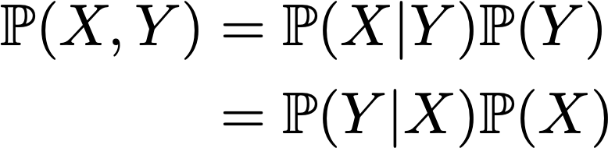
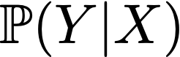
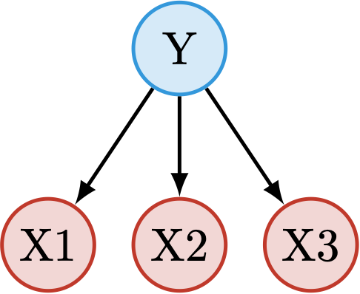
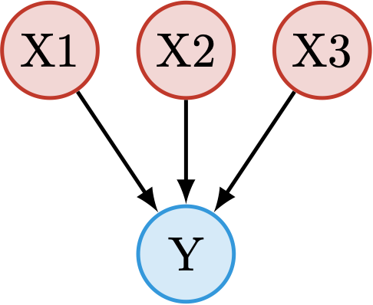
model-based classifiers
Generative
Discriminative
Naive Bayes
Probabilistic Perceptron
Notes:
Generative models describe correlation among attributes and class
Assumes both a model of input and a model of class given input
Perform better when data is scarce
Discriminative models do not model input
Perform better when data is abundant

Slide 22
bayesian networks
Directed Acyclic Graph (DAG) over random variables X1,X2,…,Xn
Conditional probability of every variable given parent’ instantiation
P(Xi|Parents(Xi))
Markov property (implies factorization)
P(X1,…,Xn)= ∏ P(Xi|Parents(Xi))
Generative models
gender
age
education
income
occupation

Slide 23
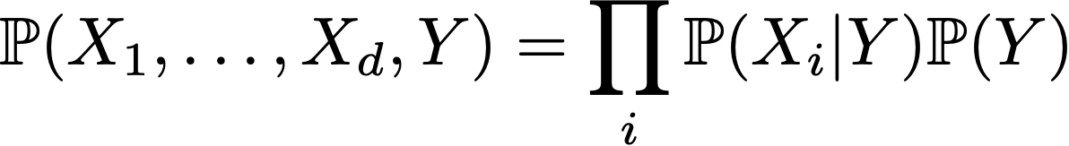
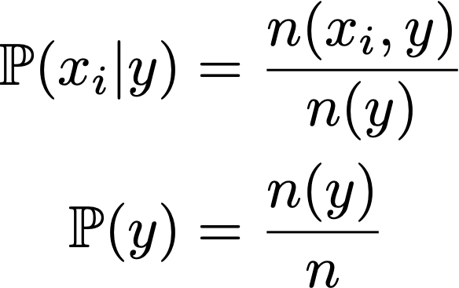
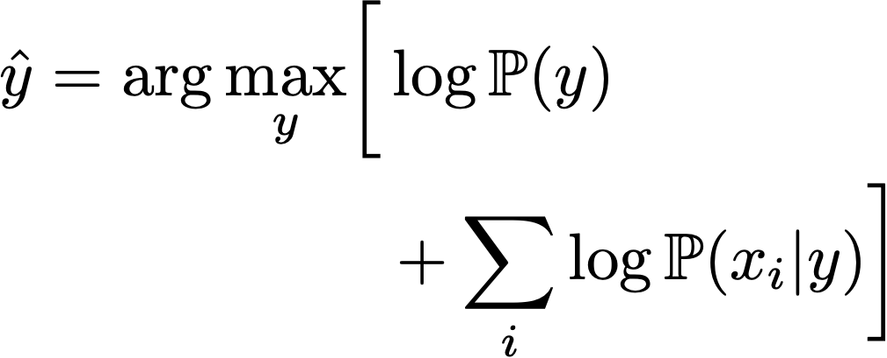
naive bayes classifier
Assume attributes are conditionally independent given class label
Learning
(assuming data is fully observable)
Classification
(assuming input is fully observable)
maximum likelihood estimators
Notes:
Naive assumption: all features are conditionally independent given the class
When number of features (dimensionality) is very high, feature correlation cannot be reliably estimated, so assumption is reasonable
Statistically efficient: linear number of parameters, can learn from few data

Slide 24

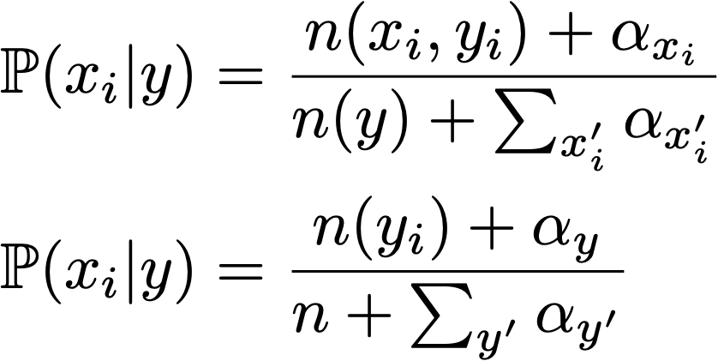
naive bayes classifier
Learning
Smoothing
maximum likelihood estimators
Bayesian estimators
Notes:
Small probabilities are difficult to estimate (zero counts on denominator)

Slide 25

naive bayes classifier
For Boolean variables, specifies separating hyperplane on input space
No longer true with multi-valued variables

Slide 26
bayesian network classifiers
Tree-augmented naive Bayes classifier (TAN)
Allow one additional parent for each attribute variable
General topology
Need to learn graph structure
Score-based methods: NP-hard optimization
Active field of research

Slide 27
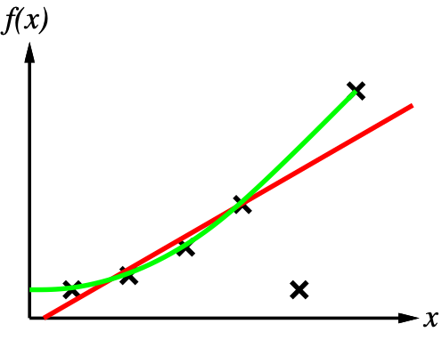
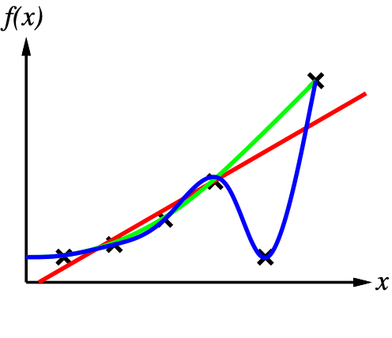
model-free learning (non-parametric)
Weak statistical assumptions about data
Or learn assumptions from data
Rule Learning
Nearest Neighbors
Decision Trees
Perceptron
Neural Networks
…
Notes:
Right: learning separating hyperplanes

Slide 28
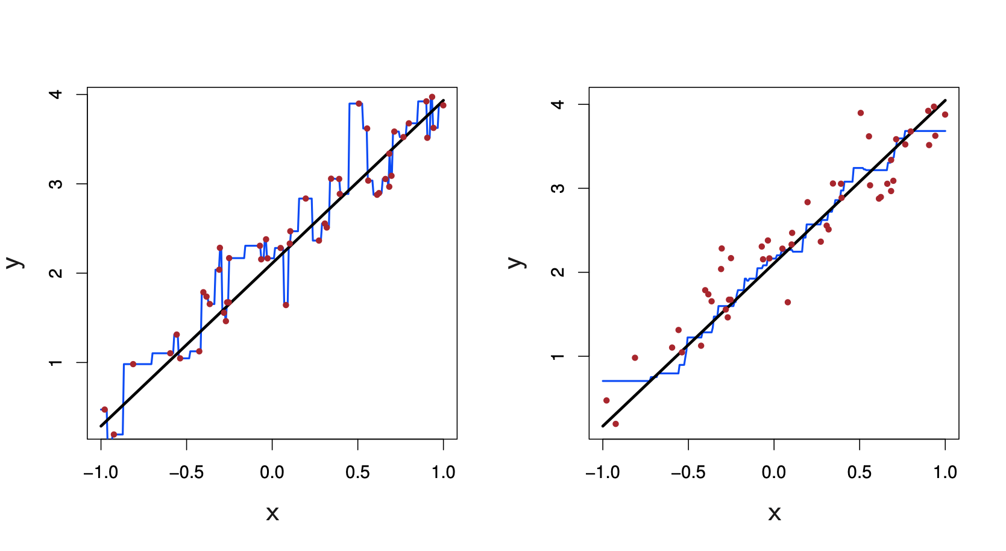
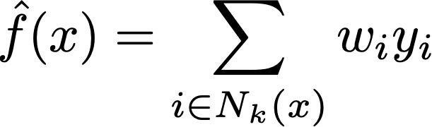
nearest neighbor regression
k=1
k=9

Slide 29
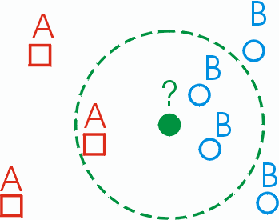
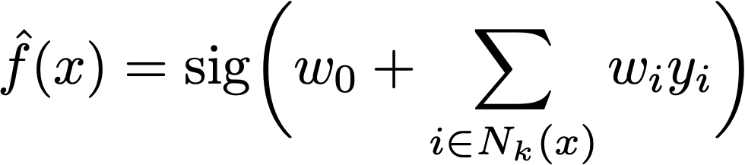
nearest neighbor classifier

Slide 30
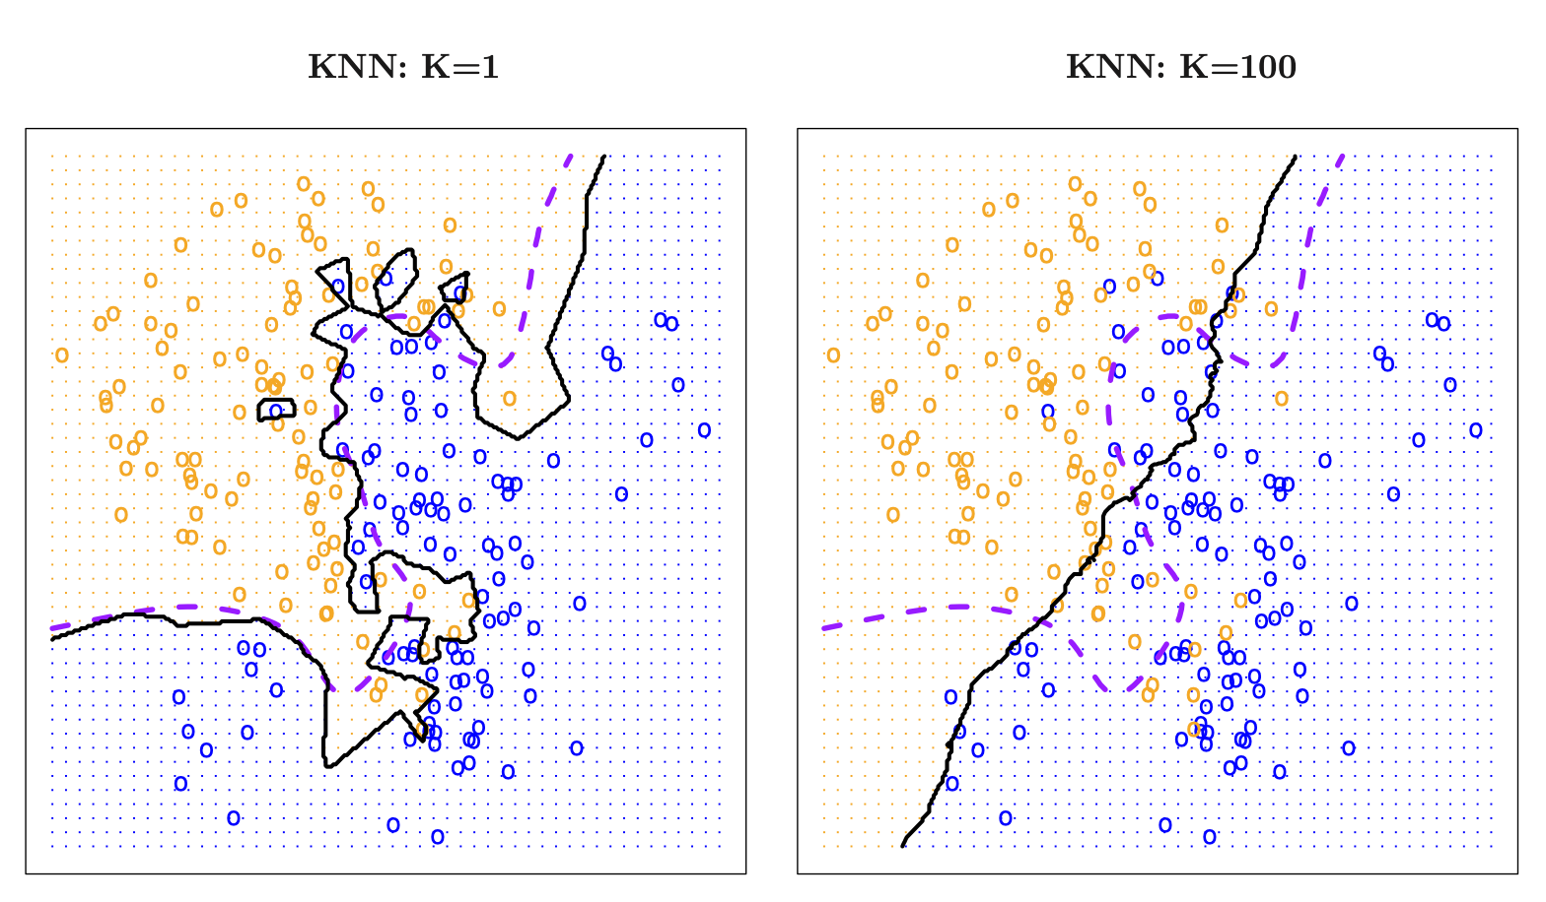
nearest neighbor classifier

Slide 31
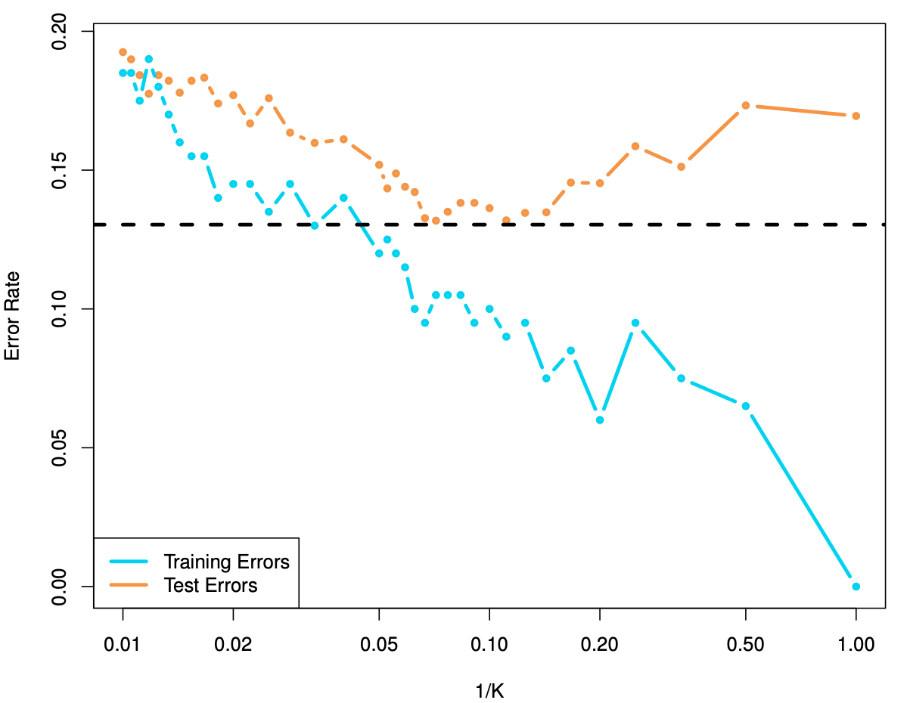
setting the number of neighbors
underfitted
overfitted

Slide 32
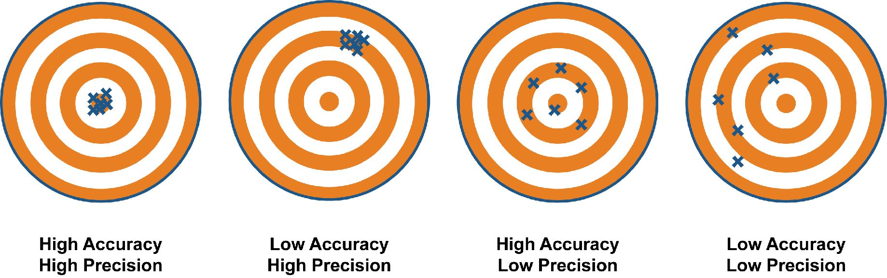
bias-variance tradeoff

Slide 33
bias-variance tradeoff

Slide 34
bias-variance tradeoff

Slide 35
decision tree classifiers
Petal Length
Internal nodes represent attributes
Edges split domain of related attribute
Leaves represent classifications
Path leads to evaluation/classification of input
≥2.45
<2.45
iris setosa
Petal Width
≥ 1.75
<1.75
Petal Length
Petal Length
≥4.95
≥4.95
<4.95
Sepal Length
iris virginica
iris virginica
iris virginica
<5.15
iris versicolor
iris versicolor
Notes:
There is only a minor similarity between Decision Tree Classifiers and the Decision Diagrams we have seen earlier (a decision tree contains only decisions)

Slide 36
decision tree regressors
Internal nodes represent attributes
Edges split domain of related attribute
Leaves represent output
Petal Length
<2.45
≥2.45
petal width = 0.3
Species
=virginica
=versicolor
Sepal Length
Petal Length
<5.15
≥4.95
petal width = 1.5
petal width = 1.9
petal width = 2.4
petal width = 1.2

Slide 37
Decision trees
Any function with finite domain can be represented as a (finite) decision tree
X1
=1
X2
X1 | X2 | X3 | Y
0 | 0 | 0 | 1
1 | 0 | 0 | 0
0 | 1 | 0 | 0
1 | 1 | 0 | 1
0 | 0 | 1 | 0
1 | 0 | 1 | 1
0 | 1 | 1 | 1
1 | 1 | 1 | 0
=1
=0
=0
X3
X3
=0
=1
X2
=1
Y=0
Y=1
=1
=0
X3
X3
=1
Y=1
Y=0
=0
=1
=0
Y=1
Y=0
Y=0
Y=1
Notes:
From a computational viewpoint, we are interested in learning decision trees that are as small as possible while closely representing the data at hand

Slide 38
geometric view of decision trees
X1
<a
≥a
X2
X2
≥b
<b
b
a
X1
Any well-behaved function can be approximated arbitrarily well by a (possibly gigantic) decision tree

Slide 39
XOR function
X1 | X2 | Y
0 | 0 | 0
1 | 0 | 1
0 | 1 | 1
1 | 1 | 0
X1
0
1
X2
X2
0
1
0
1
Y=0
Y=1
Y=1
Y=0
Notes:
Exercise: Build a decision tree to represent the XOR of two Boolean variables
Question: Can we build an accurate decision tree with less internal nodes? -No, cannot decide output based on single variable split

Slide 40
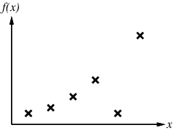
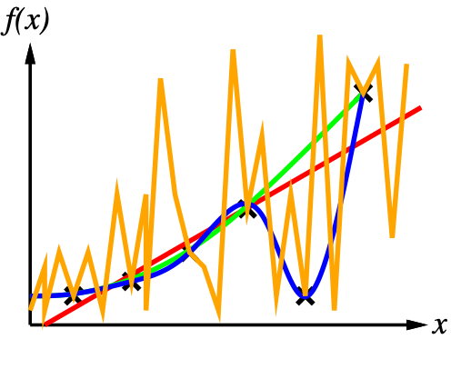
fitting, underfitting, overfitting

Slide 41
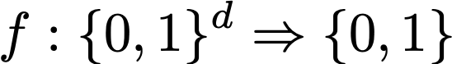
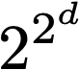
Learning decision trees
Consider the class of Boolean functions
There are of such functions (# of truth-tables)
Most functions can be represented by more than one decision tree
Hence # of decision trees is too large for e.g. uninformed search
Learning optimal Decision Tree is NP-hard
Instead Greedy Search is used

Slide 42
Learning decision trees
Small decision trees demand less computational resources and are less prone to overfitting (think of edges as parameters)
We want to learn trees that are large enough to represent data well (i.e., avoid underfitting) but not too large so as to overfit data
If dataset contains a single label for each input, we can always learn a Decision Tree that perfectly fits the data but generalizes poorly
Greedy approach: Recursively select worst decision node and expand it by selecting most informative attribute
Most informative means e.g. it performs less errors on training data when predicting majority class

Slide 43
purity
A path in the tree selects a subset of the data
We say that the data subset is pure if the class variable takes on a single value
X1 | X2 | X3 | Y
1 | 1 | 125 | 0
0 | 0 | 100 | 0
0 | 1 | 70 | 0
1 | 0 | 120 | 0
0 | 2 | 95 | 1
0 | 0 | 60 | 0
1 | 2 | 220 | 0
0 | 1 | 85 | 1
0 | 0 | 75 | 0
0 | 1 | 90 | 1
X1
=0
=1
Y=0
Y=0
0/3
3/7
Notes:
Dataset produced by X1=1 is pure while dataset produced by X1=0 is impure

Slide 44
hunt’s algorithm
Let Dt be the dataset associated with a path leading to a node t in a decision tree
HuntAlgorithm (Decision tree T, Dataset Dt)
If Dt is pure, create a decision node with the corresponding label and return that node.
Otherwise
Partition Dt into two datasets Dt1 and Dt2
Create a left child node Hunt (T, Dt1) and a right child node Hunt (T, Dt2)

Slide 45
Hunt’s algorithm
X1 | X2 | X3 | Y
1 | 1 | 125 | 0
0 | 0 | 100 | 0
0 | 1 | 70 | 0
1 | 0 | 120 | 0
0 | 2 | 95 | 1
0 | 0 | 60 | 0
1 | 2 | 220 | 0
0 | 1 | 85 | 1
0 | 0 | 75 | 0
0 | 1 | 90 | 1
Y=0
Notes:
We start with the simplest decision tree that simply decides for the majority class. We misclassify 3 out of 10 instances
So suppose we decide to augment the tree by splitting at X1

Slide 46
hunt’s algorithm
T2
X1
=0
Y=0
=1
Y=0
3/7
X1 | X2 | X3 | Y
0 | 0 | 100 | 0
0 | 1 | 70 | 0
0 | 2 | 95 | 1
0 | 0 | 60 | 0
0 | 1 | 85 | 1
0 | 0 | 75 | 0
0 | 1 | 90 | 1
0/3
X1 | X2 | X3 | Y
1 | 1 | 125 | 0
1 | 0 | 120 | 0
1 | 2 | 220 | 0
Notes:
We generate two new datasets (for X1=1 and X1=0) of size 3 and 7. The error rates in each dataset are 0 and 4/7. The mean error is therefore 3/10 * 0 + 7/10 * 3/7 = 0.4.
Note that the subtree X1=1 cannot be improved (it makes 0 mistakes). So there is no point in extending it.
The right-hand subtree can still be improved by adding a new level

Slide 47
hunt’s algorithm
T3
X1
=1
=0
X2
Y=0
=0
≠0
0/3
Y=1
Y=0
X1 | X2 | X3 | Y
1 | 1 | 125 | 0
1 | 0 | 120 | 0
1 | 2 | 220 | 0
1/4
0/3
X1 | X2 | X3 | Y
0 | 1 | 70 | 0
0 | 2 | 95 | 1
0 | 1 | 85 | 1
0 | 1 | 90 | 1
X1 | X2 | X3 | Y
0 | 0 | 100 | 0
0 | 0 | 60 | 0
0 | 0 | 75 | 0
Notes:
So suppose we select X2 to split, generating two more datasets. The first dataset (X2 ≠ 0) misclassify 1/4 instances; the second dataset (X2 = 0) generates a perfect classification
So we can still split dataset X2 ≠ 0

Slide 48
hunt’s algorithm
X1 | X2 | X3 | Y
1 | 1 | 125 | 0
0 | 0 | 100 | 0
0 | 1 | 70 | 0
1 | 0 | 120 | 0
0 | 2 | 95 | 1
0 | 0 | 60 | 0
1 | 2 | 220 | 0
0 | 1 | 85 | 1
0 | 0 | 75 | 0
0 | 1 | 90 | 1
T4
X1
=1
=0
Y=0
X2
0/3
≠0
=0
Y=1
X3
<80
≥80
0/3
Y=0
Y=1
0/1
0/3
Notes:
Splitting dataset X2 ≠ 0 at X3 we generate

Slide 49
Selecting attributes
Splitting on X1
Splitting on X2
4/3
0/0
4/3
0/0
4/2
0/1
4/2
0/1
4/1
0/2
3/2
1/1
4/0
0/3
X2
3/1
1/2
3/0
1/3
3/0
1/3
2/0
2/3
2/0
2/3
X1
1/0
3/3
1/0
3/3
0/0
4/3
0/0
4/3

Slide 50
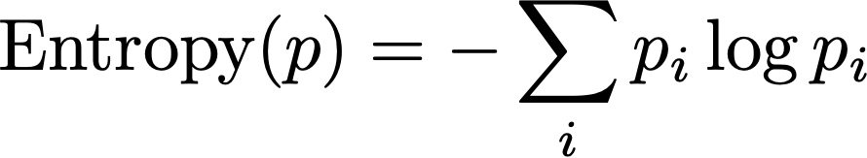
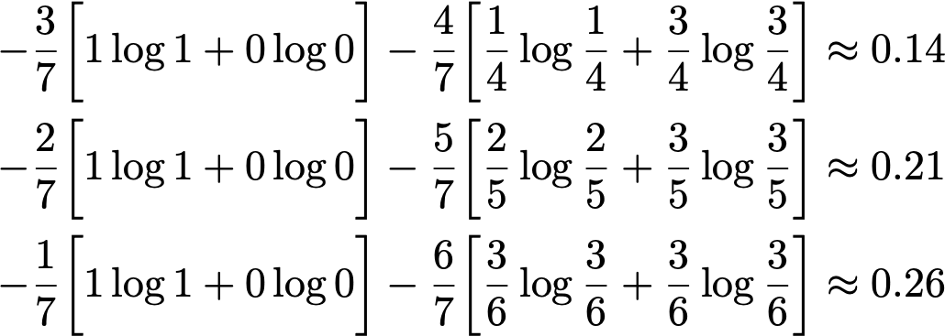
SELECTING ATTRIBUTES
Requires a measure of “unbalancedness” of partition
Overall quality of a split is the weighted “unbalancedness” of the partitions it induces
Several metrics: Gini index, classification error, entropy, …
Entropy:
3/0
1/3
2/0
2/3
1/0
3/3
Notes:
The best split generates datasets where the class takes on a single value (this is a perfect classification)
In general, there is not perfect split. So we want to get as close as possible to a perfect split
No single definition of closeness to perfect split

Slide 51
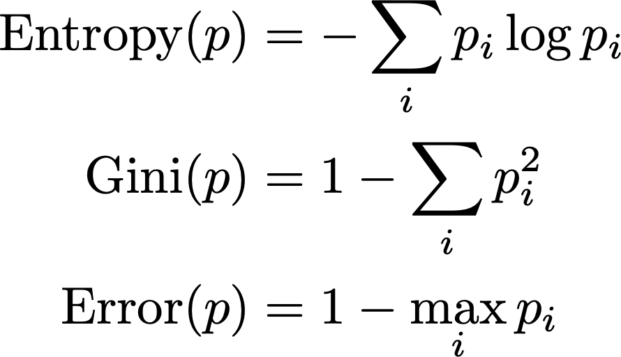
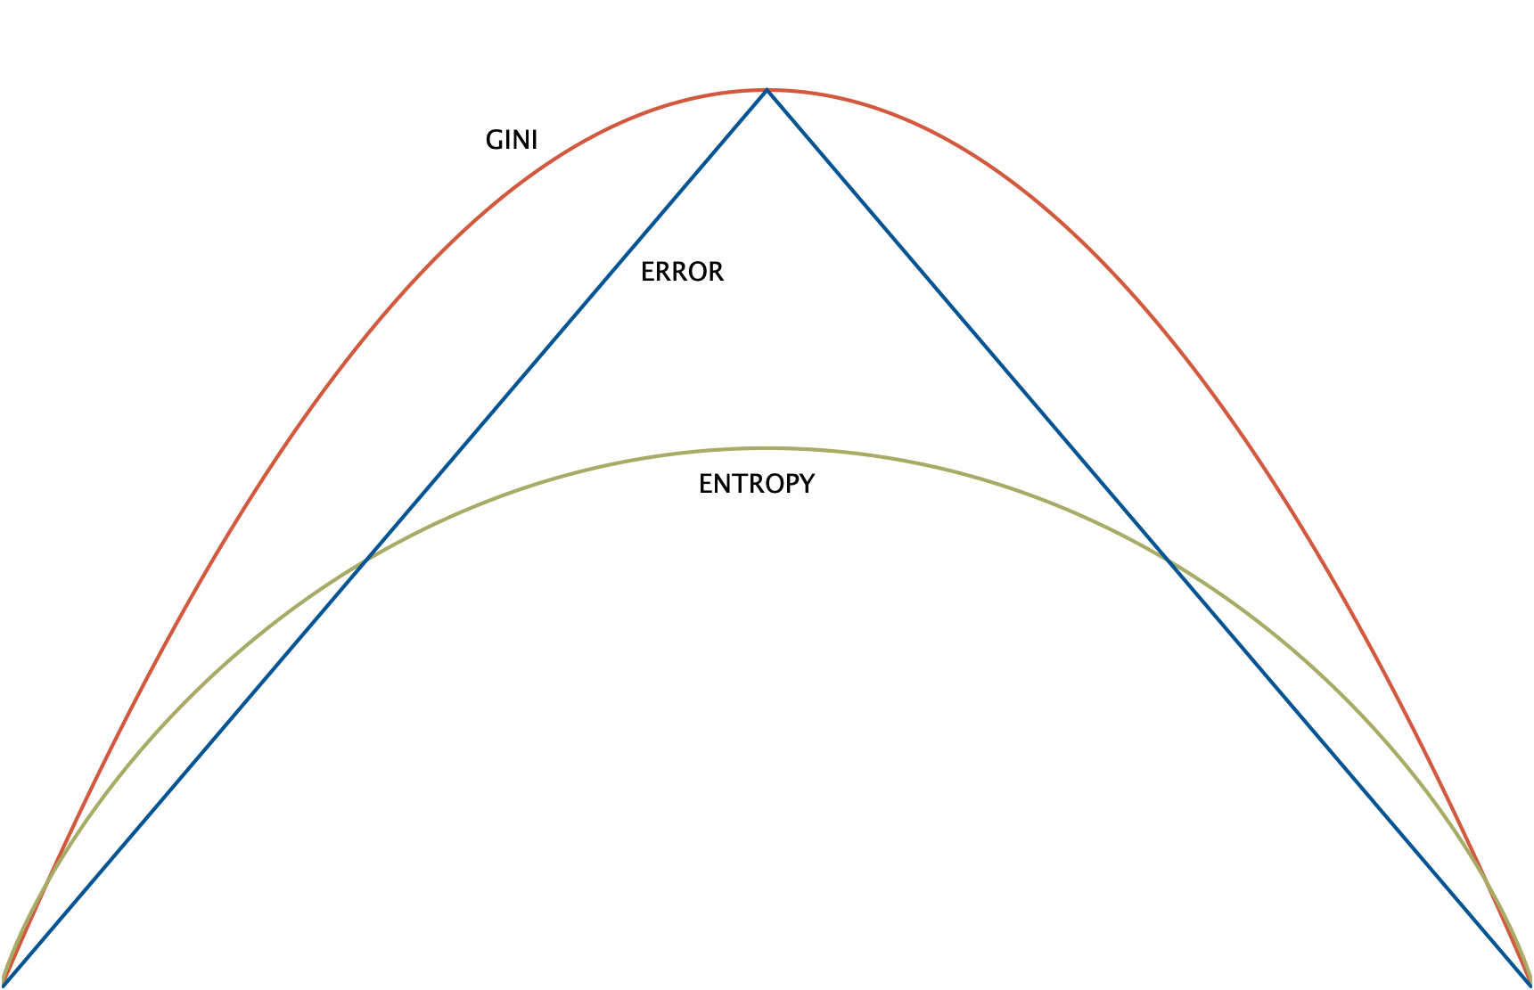
selecting attributes
1/2
p

Slide 52
Decision trees
Several algorithms: Hunt’s, CART, ID3, C4.5, …
Growing full tree leads to overfitting: use early stopping criteria (e.g. stop when gain in splitting falls below a threshold)
Pruning techniques: remove leaves that increase classification error on unseen data
Several design choices: splitting criteria, stopping criteria, multiway vs. binary split, pruning criteria
Random forests (sets of trees) achieve state-of-the-art performance
Build ensemble of decision trees using different subsets of features
Splitting on (linear) function of variables increases accuracy

Slide 53
standard methodology
Split data into training set and test set Tune parameters using part of training data set (validation set) | Evaluate generalization on test set Cross-validation: split training data into k folds, train on all but i-th fold, evaluate on i-th fold; collect statistics
test | train | train | train | train
train | test | train | train | train
train | train | test | train | train
train | train | train | test | train
train | train | train | train | test
90% | 89% | 93% | 91% | 92% | 91±1.5%
training
validation
test

Slide 54
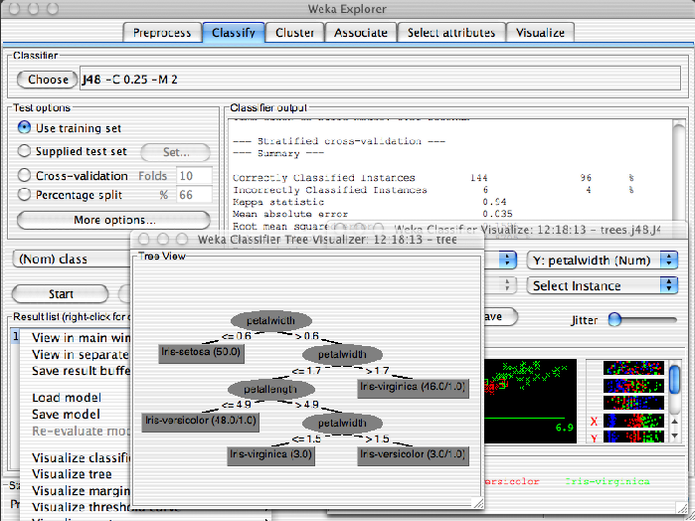


softwares and libraries
Weka: www.cs.waikato.ac.nz/ml/weka/
Machine Learning Toolbox with GUI
R: www.r-project.org
Statistical Toolbox with Interactive Console
Orange: orange.biolab.s
ML toolbox with GUI
Shogun: http://www.shogun-toolbox.org
ML toolbox with support to several languages

Slide 55

bibliography
Chapter 18 of AIMA Book
James et al. 2013. Introduction to Statistical Learning. Springer.
Witten & Frank. Data Mining: Practical Machine Learning Tools and Techniques

